Slide 1
How to apply ALM to Enterprise Business Analysis
ThinkersWare ALM Consulting
http://alm.thinkersware.com

Slide 2
Антон Витязь
Enterprise Solutions Consultant @ ThinkersWare
Group Leader @ Infopulse Ukraine
18 лет в IT
Developer -> System Analyst -> Business Analyst -> Consultant
Java, C/AL, X++, C#, Typescript, React
Navision, Axapta, SharePoint, Dynamics
Web, Mobile
Проекты в разных странах - Украина, Бруней, Исландия, Норвегия, Швеция, Швейцария, Венгрия, Чехия
Спикер ИТ конференций – BACON, Thinkstage, DAKIRY

Slide 3
Agenda
Today we are focus on Business Analyst practice and how we can improve it with better ALM adoption based on Microsoft Azure DevOps Tools.

Slide 4
Agenda
1
What is ALM for you
Current practices, how your BA practice fit with ALM, why you out of ALM and what issues and risks affect you and your team.

Slide 5
2
ALM OOB
What Microsoft Azure DevOps offers to your NOW with out of the box? What you can use ang got benefits now.
3
Extend ALM
Microsoft Azure DevOps offers process model extensions: you can add custom work types, add new fields and change work item forms. Understand SWOT of customized ALM, some suggestions and next steps

Slide 6
4
Explore
Explore customized process and some sample cases
Think. Do. Repeat

Slide 7
1. What is ALM for you?

Slide 8
What a name
Azure DevOps
Thanks to the new name for TFS we got some cognitive confusions when we are talking about Microsoft Azure DevOps services. Its perceived as a solely tech tools for wired engineers at the -1 floor of the software development factory.

Slide 9
What a pleasure to be
Business Analyst
Something very nice and very business. Full of insights, model and communication with stakeholders

Slide 10
Your current practice
Pipelines
Work
Common ALM applications
CICD, testing
Backlog, Bugs, Issues
Code
Communication
Git repository
Team chats, wiki

Slide 11
01
Gather requirements
Analyze, Model, Design
02
Communicate
Business analyst
03
Gain approvals
04
Start from inputs documents, notes. Create process and domain model, detail use cases. Plan communications, clarify questions. Track approvals.

Slide 12
WRITE HERE SOMETHING ABOUT
Out of ALM things
01
Documents
02
MoM
03
Stakeholders
Not stored in version control
Questions and answers, agenda and participants
List of stakeholders, linked requirements
04
Initial inputs
05
Business Process
06
Domain Model
Stakeholder raw inputs, initial requirements
Business process model
Entities, attributes
07
Use Cases
08
FR and NFR
09
Approvals
Detailed description for Use Cases
List of functional and non-functional requirements
Track what has been approved by customer

Slide 13
Convenient tools
Word, Excel and Visio fully supports basic documents, data and models. Simple tools accepted by all stakeholders and team members.
Big tools is Big tools
Matter of license cost, complex adoptions, non flexible models. Rarely team could purchase all licenses for all stakeholder and than adopt it.
Time limits
But I must explain to you how all this mistaken idea of denouncing pleasure and praising pain was born and I will give you a complete account of the system

Slide 14
Versions trap
Documents and records are out of version control.
Limited collaboration
In most cases one user work with one document.
Complexity
Big documents with a lot of information. It’s hard to divide parts by state (approved or not, completed or draft)

Slide 15
Adopt ALM as-is
Start to use it widely with a current process. Adopt repository, wiki pages and start to use basic work items widely.
Key ideas to change things
Secret receipt
Extend process
Put in your specific BA work items: Business process, Stakeholders etc.
How you can do better business analysis with Microsoft Azure DevOps
Use it
Every day, each time. Promote among your colleagues and other stakeholders.

Slide 16
2. ALM Out of the Box

Slide 17
PUT YOUR GREAT SUBTITLE HERE
Initial setup
Setup Organization
Consider Costs
It is VERY easy to get your new organization with – https://dev.azure.com – any email and you are @ ALM
Free for 5 users
Free for MSDN Subscription
Free for any Stakeholders
Around 6$ for additional user
http://alm.thinkersware.com/setup/

Slide 18
Microsoft Azure DevOps
Out of the Box capabilities
Work item
Customization
Emails
You can track requirements, issues, risk, bugs etc
You can create new fields to the current work items or create your new one
Notify key users, sent links, send Excel files with exported data
Query
Repository
Communications
Advanced flat and hieararchy flat
Store almost unlimited content – documents, files, media, code
Integrate to your collaboration environments

Slide 19
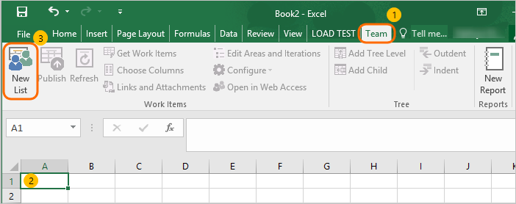
Killer feature
Excel Sync
Export any set of work items with Query – list of fields, sorting and order
Send it to customer / Store at Repository
Update and sync back to Azure DevOps
Enable offline store, Mass update, Mass inputs, Easy to create and change hierarchy
http://alm.thinkersware.com/tools/excel/install-excel-plugin/

Slide 20
Lost hours, lost hopes
Cruel facts
#01
Manual entering
Hundreds of requirements entered manually from Excel and Word lists
#02
Mass updates
Repeatable operations one by one
#03
Build hierarchy
New items, child relationship done manually

Slide 21
3. Extend your ALM

Slide 22
Extensions approaches
Minor to existing work items – fields, change state model
Mixing work items – mix Agile and CMMI
Completely new set of work items

Slide 23
How Microsoft Azure DevOps fits BA tasks
ALM for BA SWOT
Strengths
Weakness
Availability, Price, Wide adoption, Easy to use for records, Customizable
Visualization, No Lookups , Lack of BA models adoptions
Opportunities
Threats
New plugins, flexibility to adopt new Business Analysis models
Business adoption issues

Slide 24
Enterprise Business Analysis Process
Extend ALM applications
New work items
Track all information inputs
Business Process Model
Business Domain Model
Link visual models with work items
Detailed use cases description
Process, Action, Event
Entity, Attributes
Stakeholder, Inputs
Use Case, Use Case Step, Actor
http://alm.thinkersware.com/business-process-model/

Slide 25
4. Explore Sample Case

Slide 26
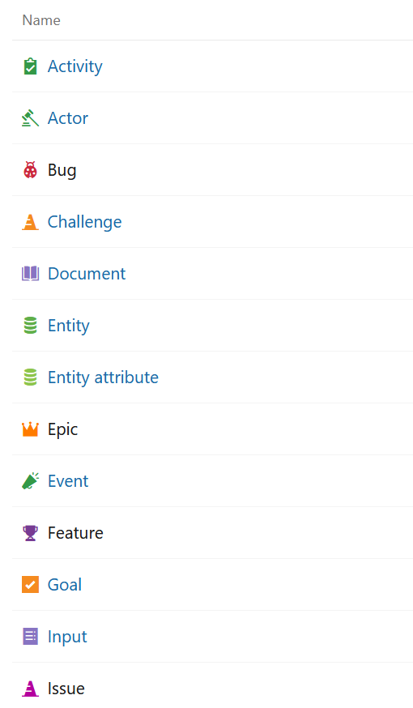
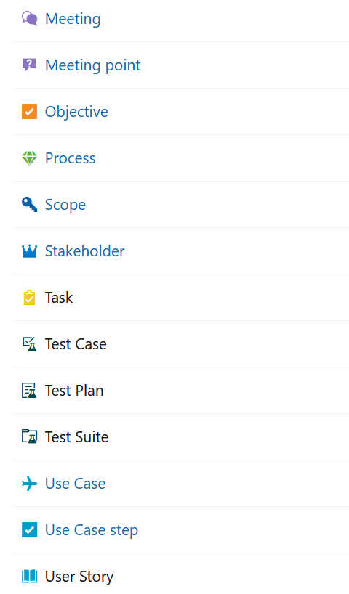
Sample EBA Process
Process includes mix of Enterprise Business Analysis work items.
Project with some demo data using this process template - https://dev.azure.com/ThinkersWareDemo/Pub_Process

Slide 27
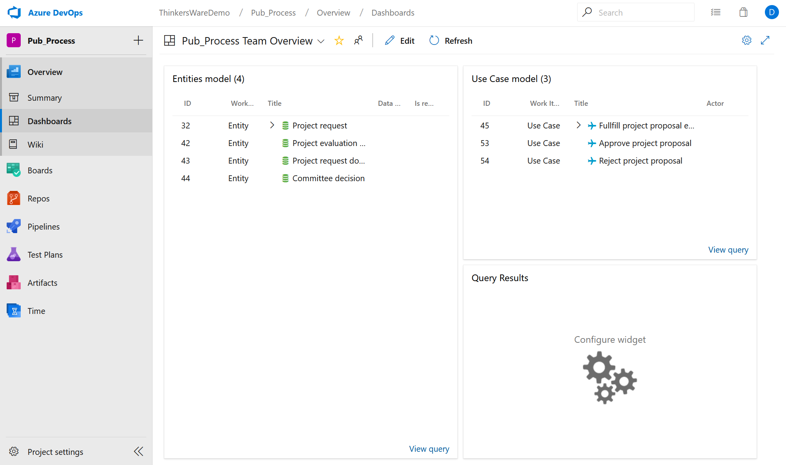
Project setup
One sample process
Data model
Use Cases model

Slide 28
Work with Inputs
What you usually receives: Documents, E-Mails, Informal information. You can dig for external data sources.
How ALM can support you:
Store document at Git or WiKi
Track document register
Document minutes of meetings
Track key statements
State questions, issues
< Live Demo>

Slide 29
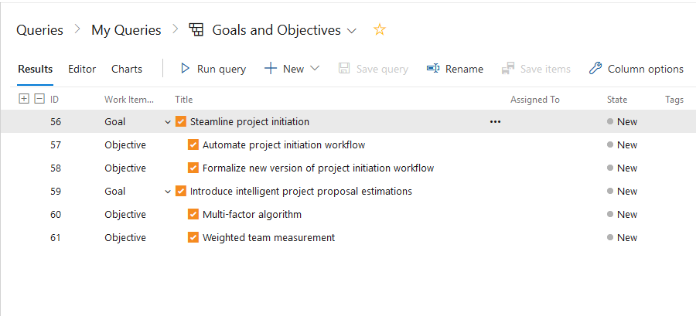
Strategic BA & PM
Understand business motivation – what kind of challenges stay underneath, how business define goals and objectives. Clearly state scope, expected deliverables and limits. Maintain list of stakeholders.
How ALM can support you:
Track Goals and Objectives
Track Constraints and Decision
Define Scope
Track Stakeholders

Slide 30
Prepare to Meeting
Collect agenda points, track participants
How ALM can support you:
Meeting, Meeting point
Meeting notes at Wiki

Slide 31
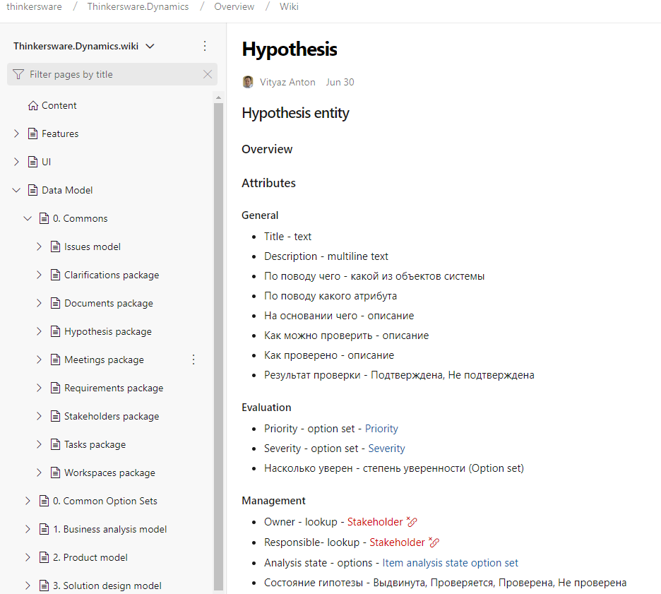
Share Content
Share content with multiple stakeholders, receives their inputs and updates.
How ALM can support you:
Wiki pages
Excel files
Visio files connected to work items

Slide 32
Process model
Manage business process model as-is and to-be. Link process steps to system use cases. Track related discussions, issues.
How ALM can support you:
Track process as items
< Live Demo>

Slide 33
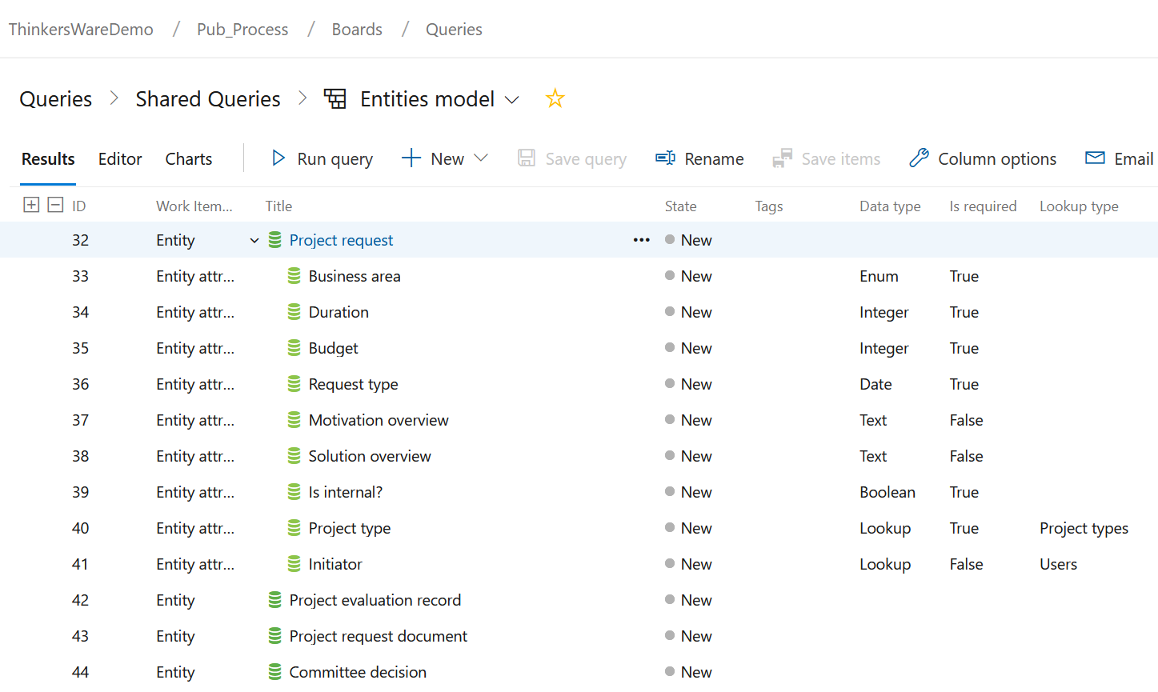
Domain model
Depict key entities and attribute. Track approvals and changes. Link to discussions.
AL
Entities and Attributes
Link Questions to model

Slide 34
Use Case model
Deliver detailed use case specification with a Use Case and Use Case Step work items ALM

Slide 35
5. Think. Do. Repeat

Slide 36
Enjoy Azure DevOps
Create own organization
Join Thinkersware Demo Instance

Slide 37
01
Common EBA model
02
Shared Cases
03
Share Practices

Slide 38
Read
Azure DevOps Knowledge warehouse
http://alm.thinkersware.com/

Slide 39
Contacts
Feel free to contact me with any questions you want to ask me ☺
Facebook: anton.vityaz
Skype: anton.vityaz
Anton.Vityaz@gmail.com
+380-66-0043-073
Ukraine

